Slide 1

BUSINESS ON CLOUD
COMPARISON OF THE SERVICES AVAILABLE IN THE MARKET FOR CLOUD INFRASTRUCTURES
-Deepthi TM

Slide 2
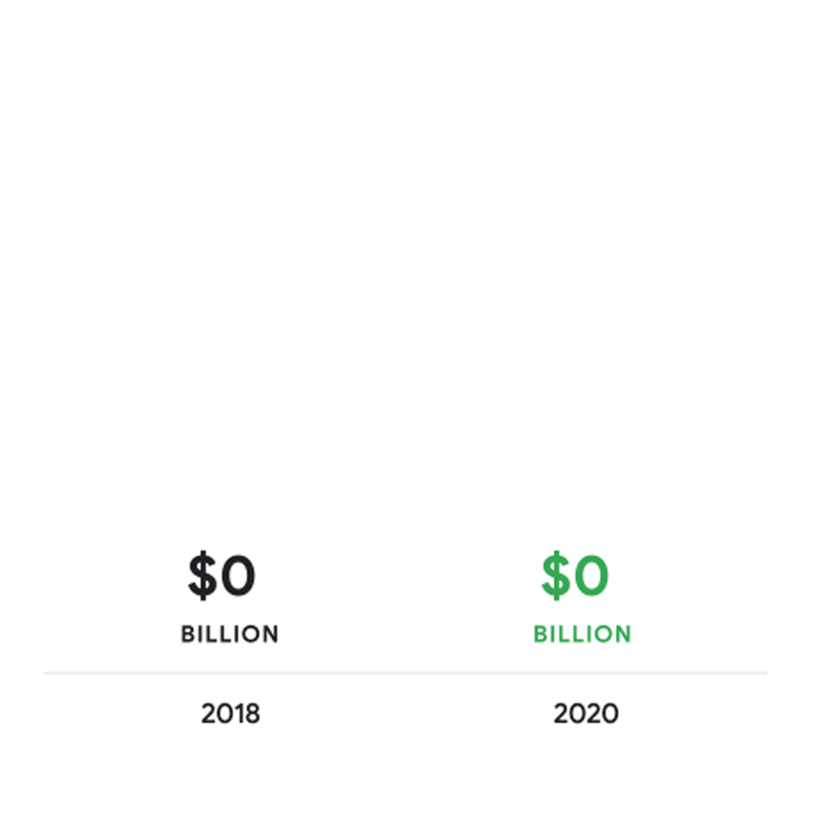
Why Cloud?

Slide 3

DIFFERENT CLOUD VENDORS

Slide 4
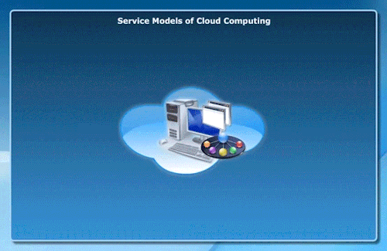
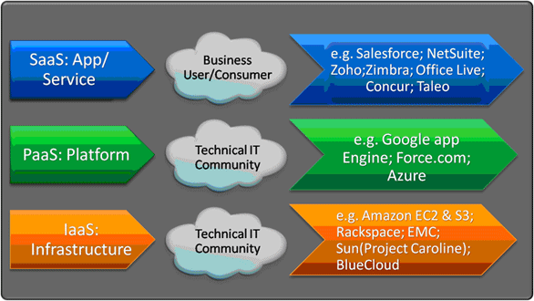

Slide 5
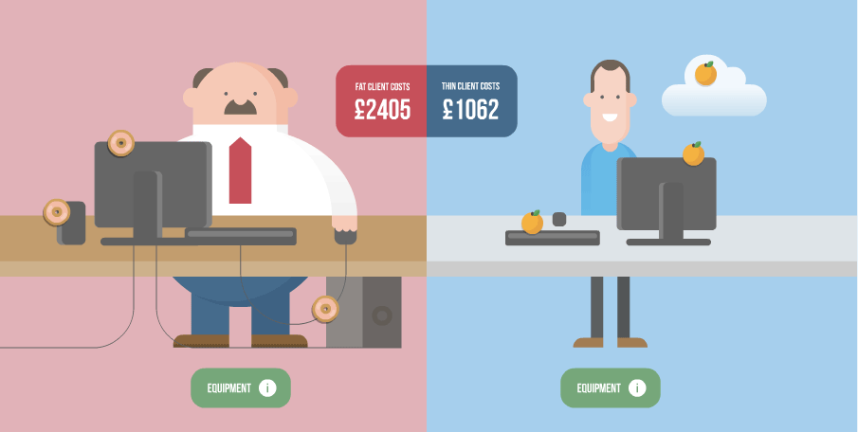
WHY TO COMPARE?

Slide 6
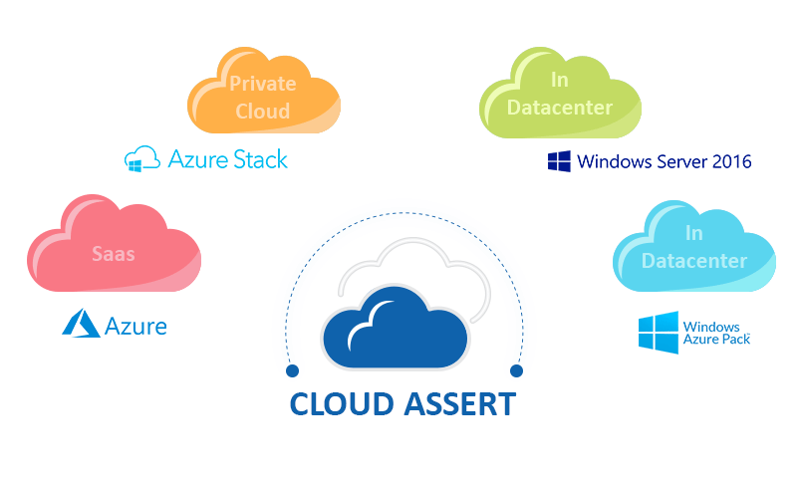

Slide 7
GENERAL DIFFERENCES
 | AWS | Microsoft Azure | GOOGLE
Started | 2006 | 2010 | 2011
Availablity zone | 55+8 | 44+12 | 18+3
Market Share | 40 | 30 | 10
Who is using them | Netflix,Airbnb,bmw,samsung,mi | honey well,apple,adobe,HP | target,Dominos,HSBC,Paypal,20th century fox
Down Time | 2014(2 hrs 89 min | 39 hrs | 14 mins

Slide 8
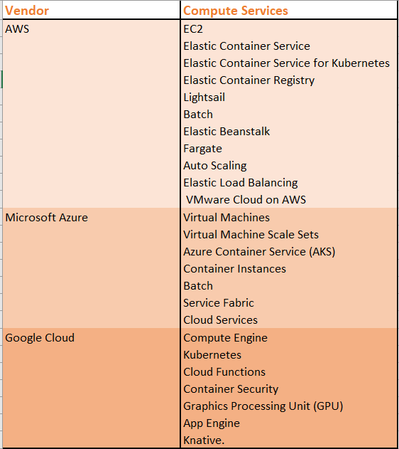
Computing Services

Slide 9
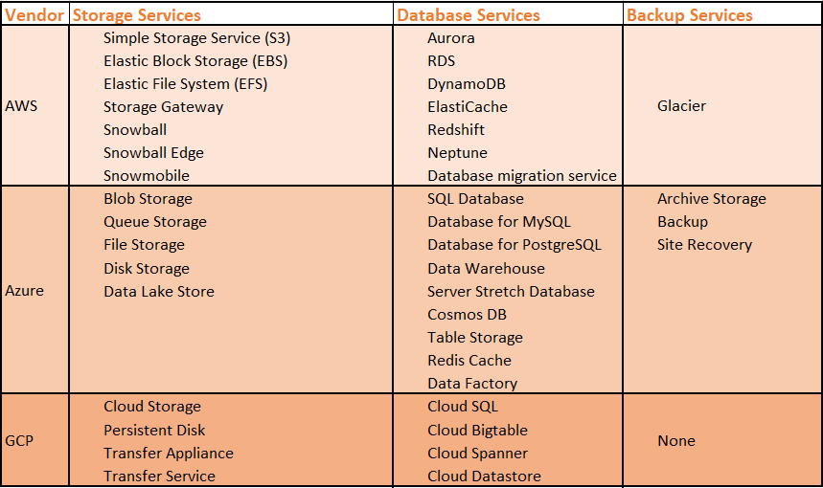
STORAGE

Slide 10
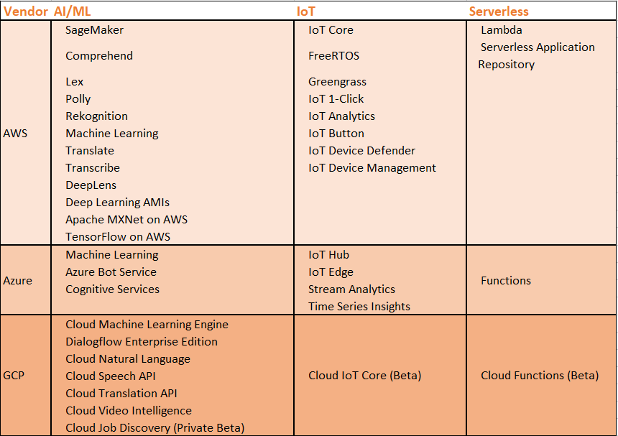
OTHER SERVICES

Slide 11
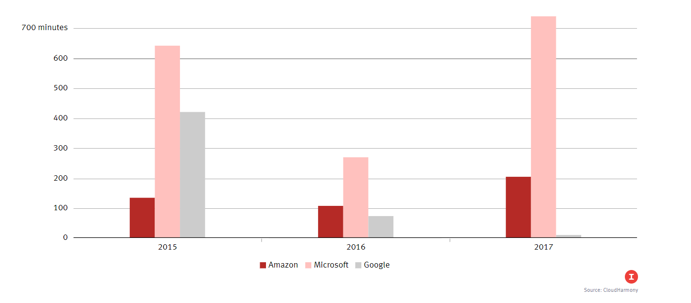
DOWN TIME

Slide 12
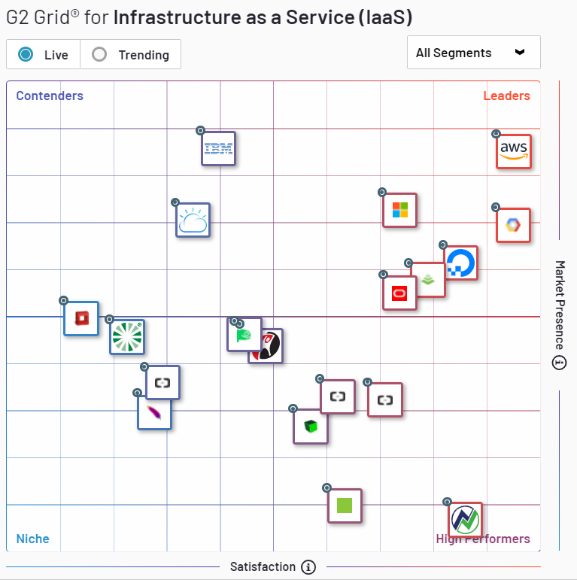
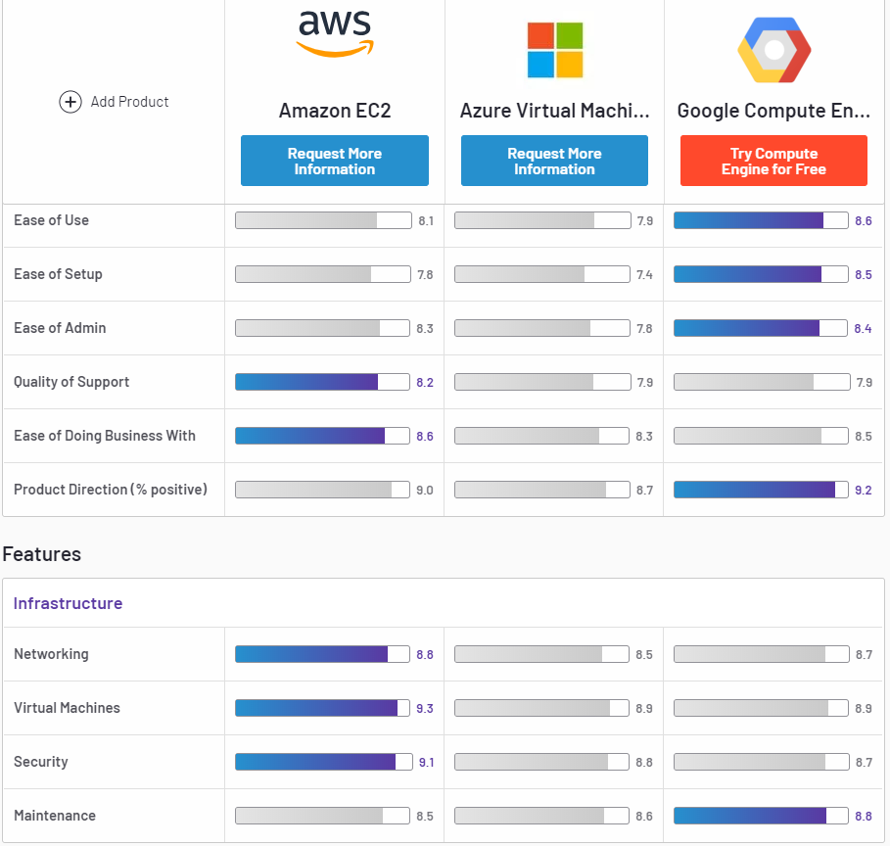
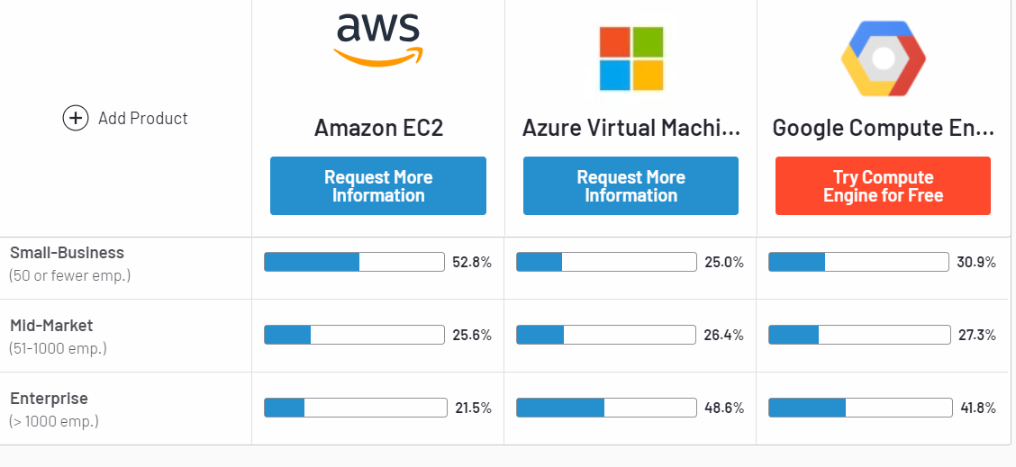
PLATFORM WISE COMPARISON BASED ON CUSTOMER REVIEWS (IaaS)

Slide 13
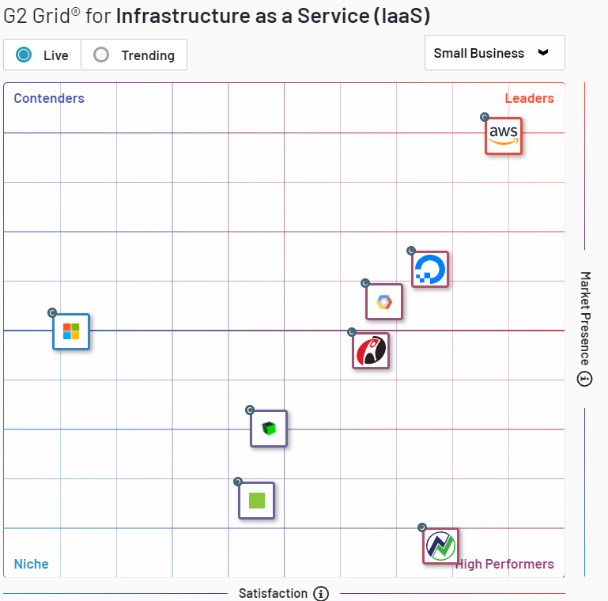
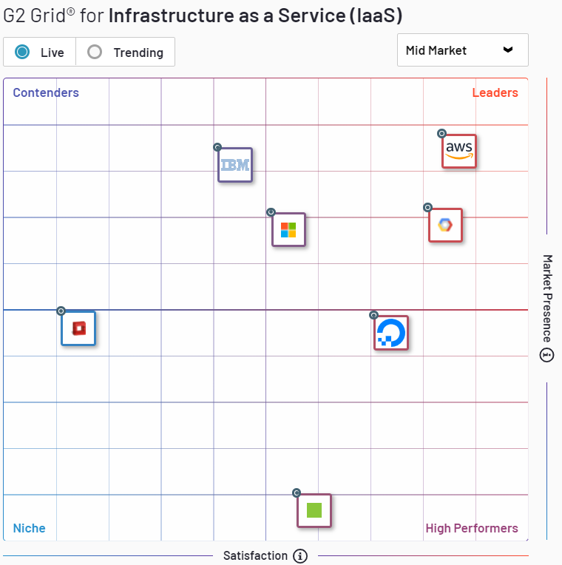
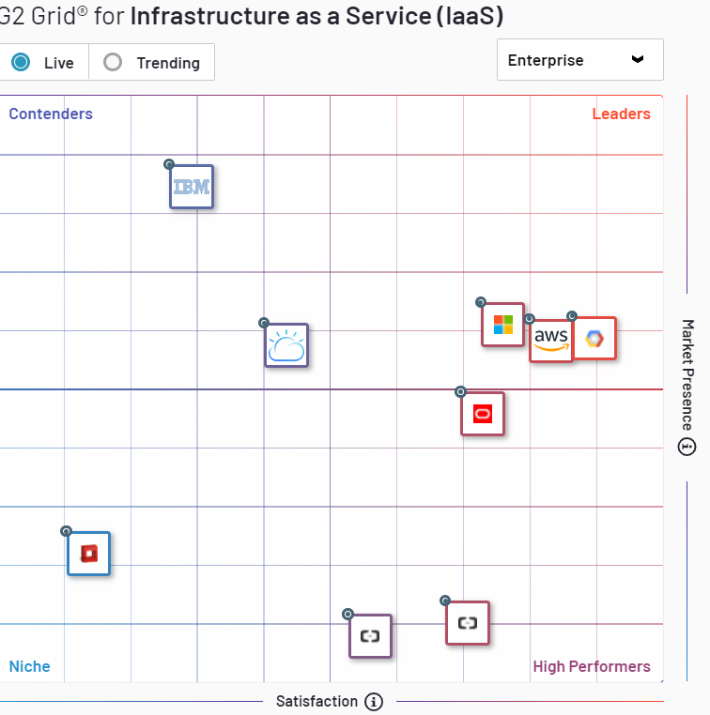
BUSINESS SIZE?(IaaS)

Slide 14
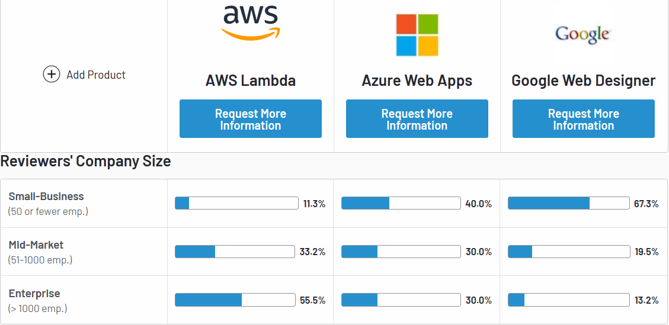
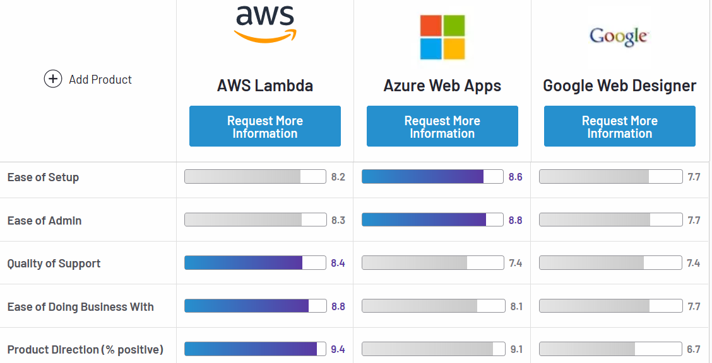
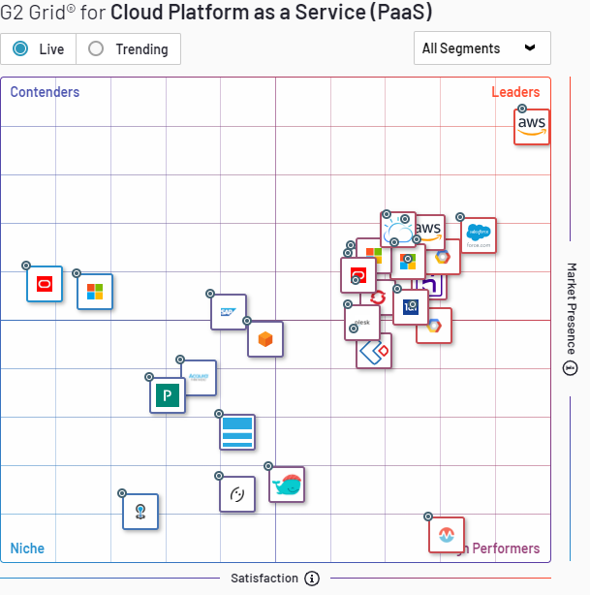
PaaS

Slide 15
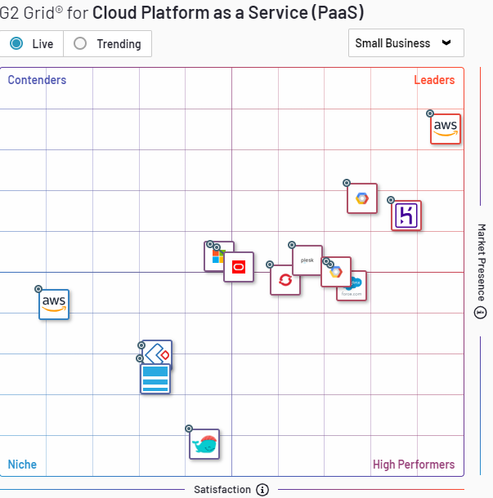
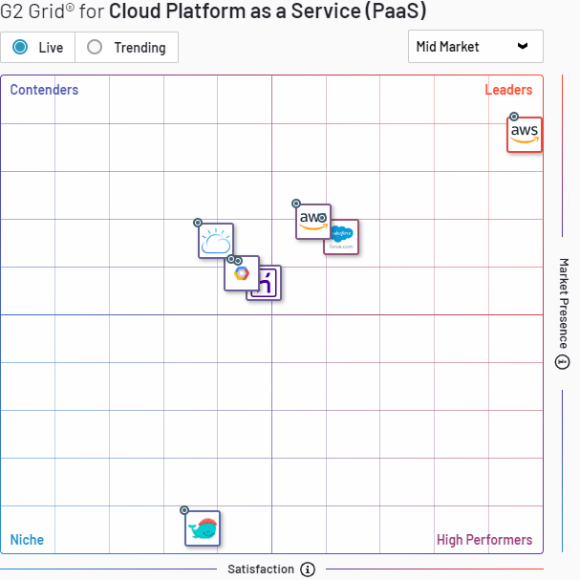
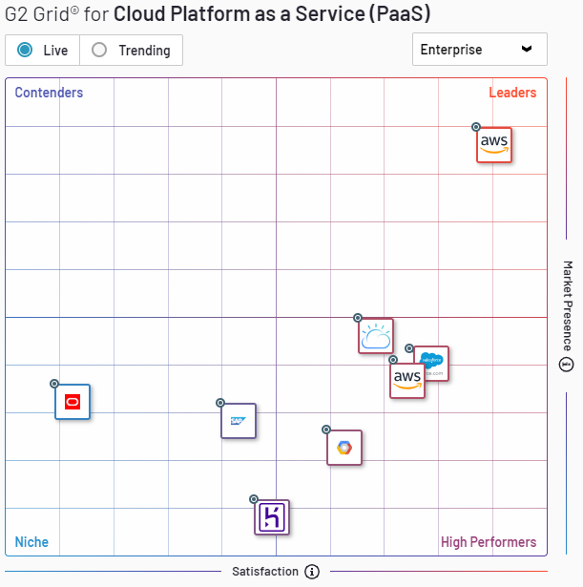
Business Size?(Paas)

Slide 16
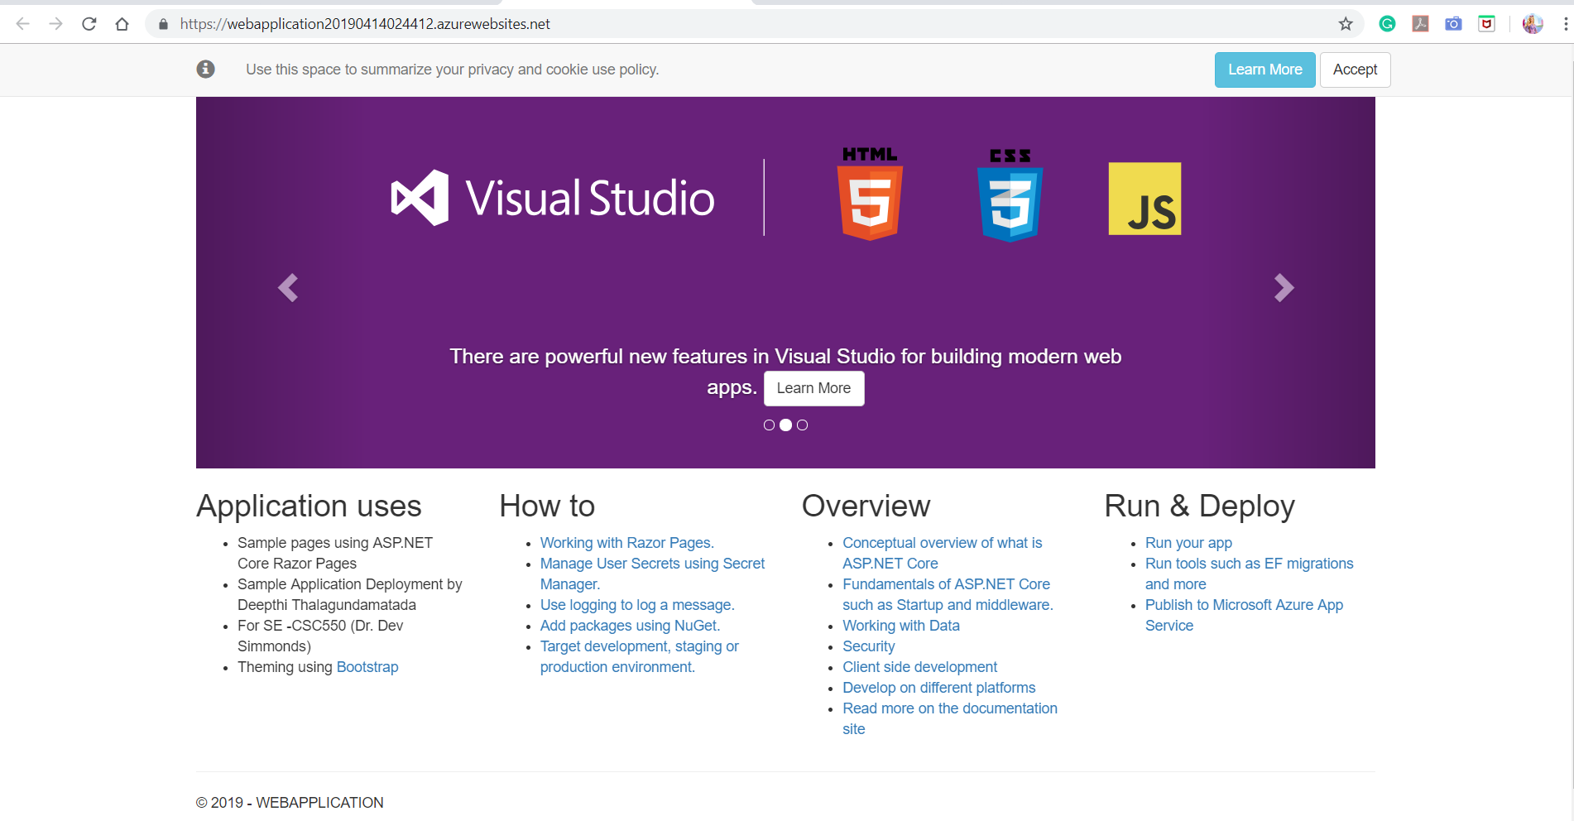
Azure Application deployed screenshot

Slide 17
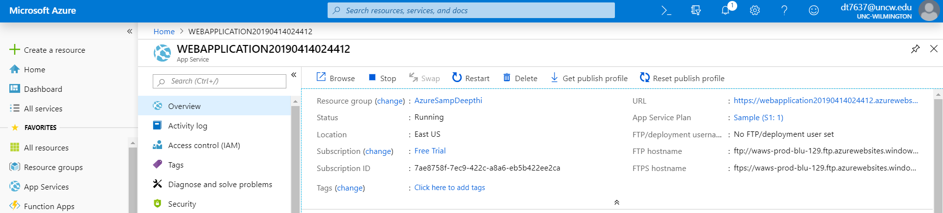
Azure Application deployed screenshot

Slide 18
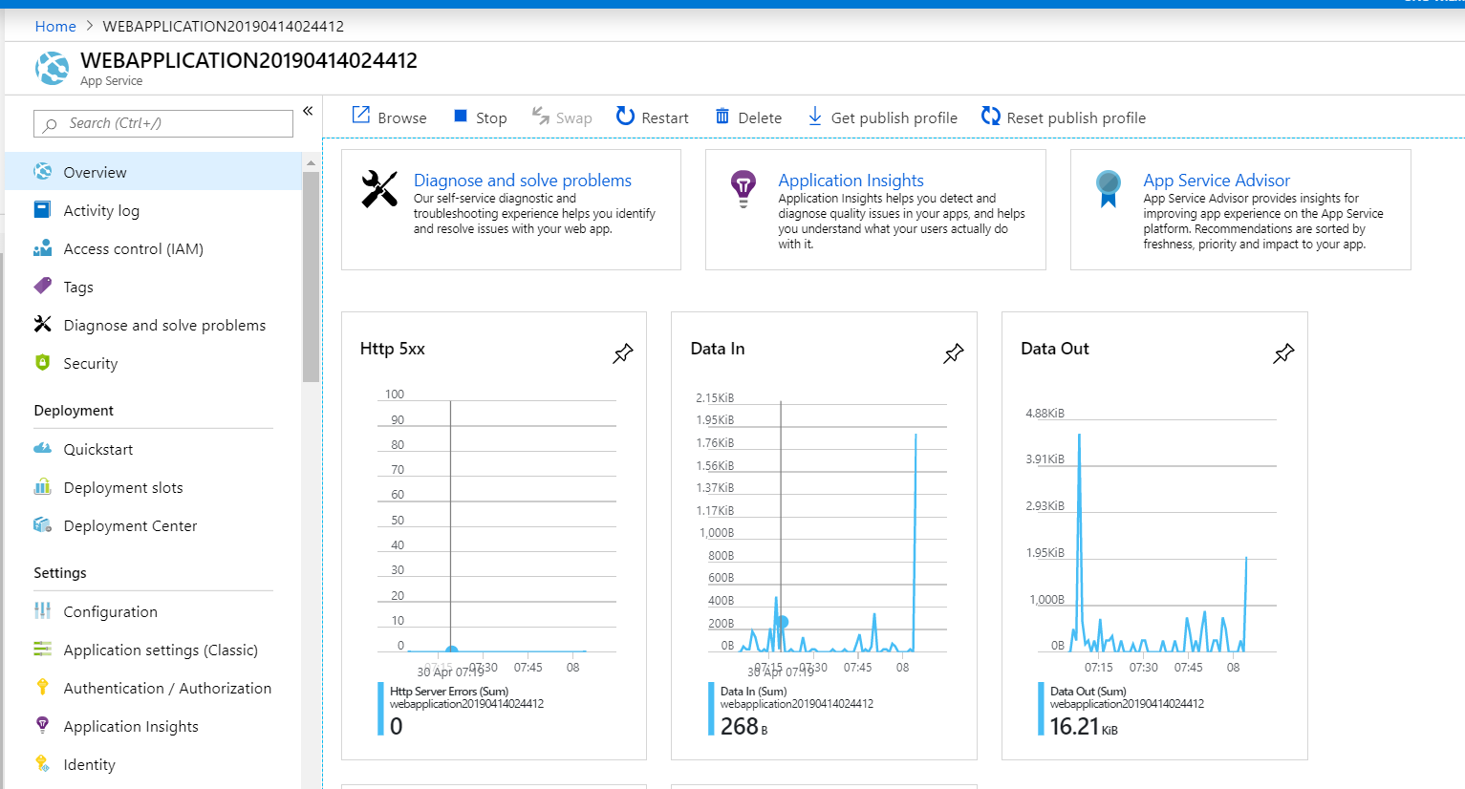
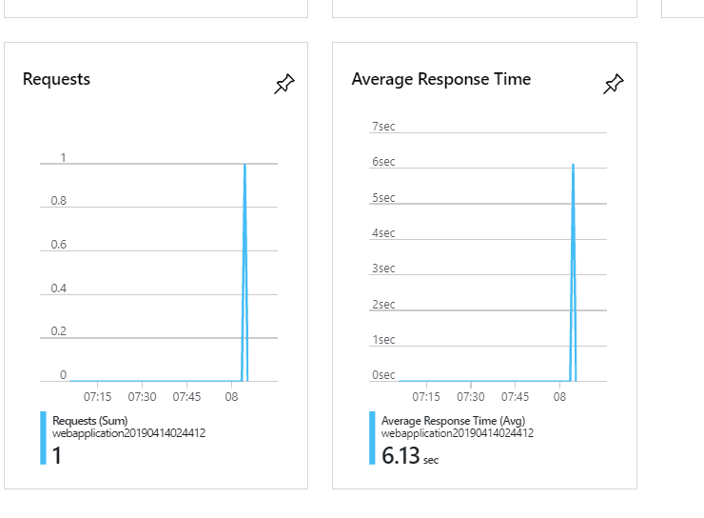

Slide 19
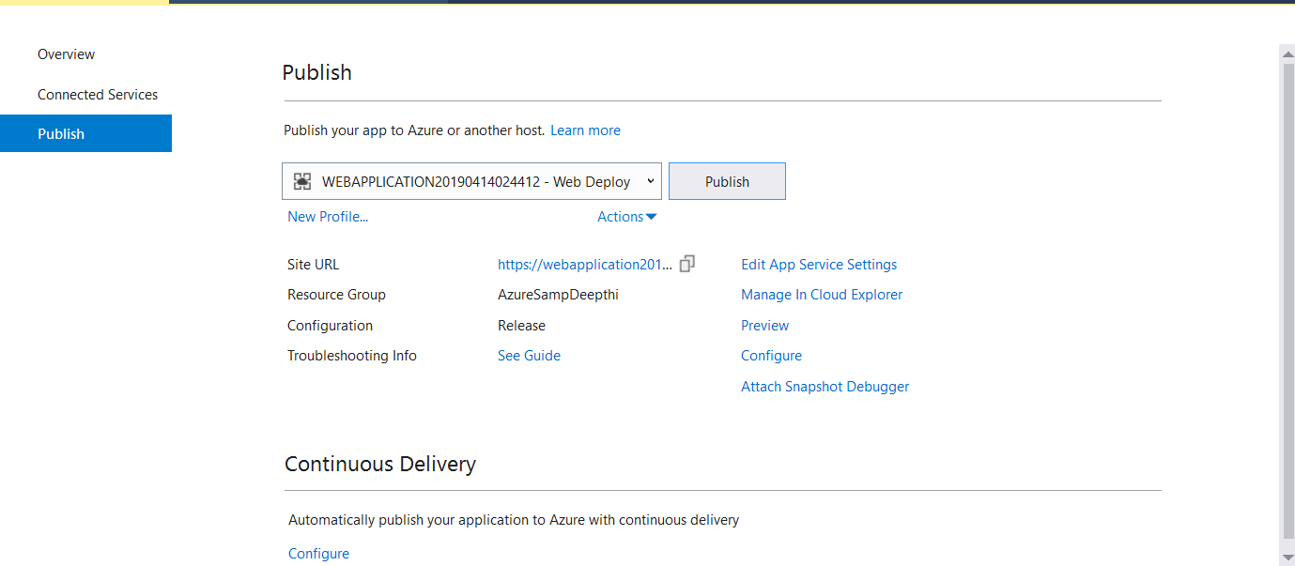
Azure Application publishing page screenshot

Slide 20
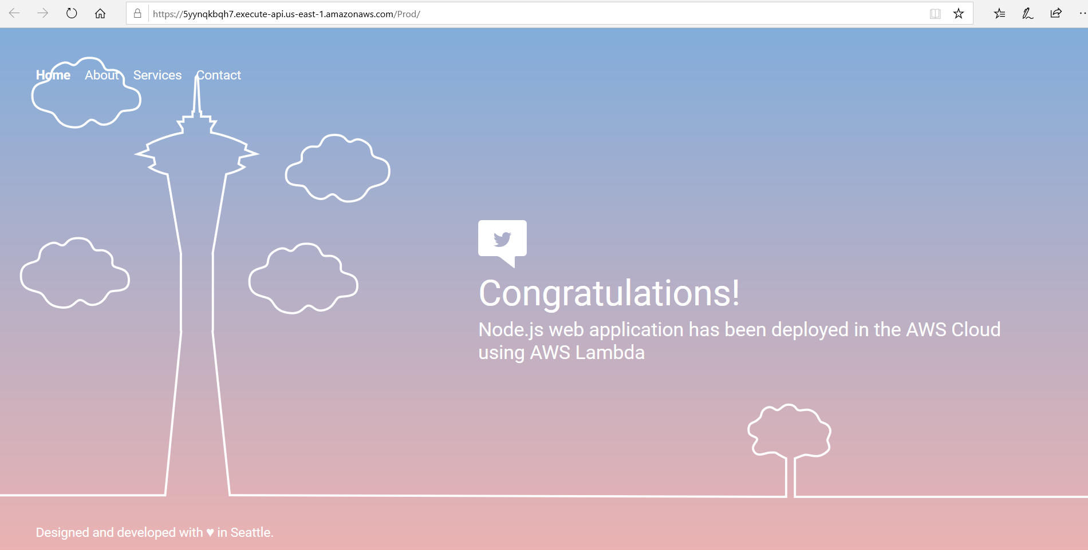
Application using AWS Lambda

Slide 21
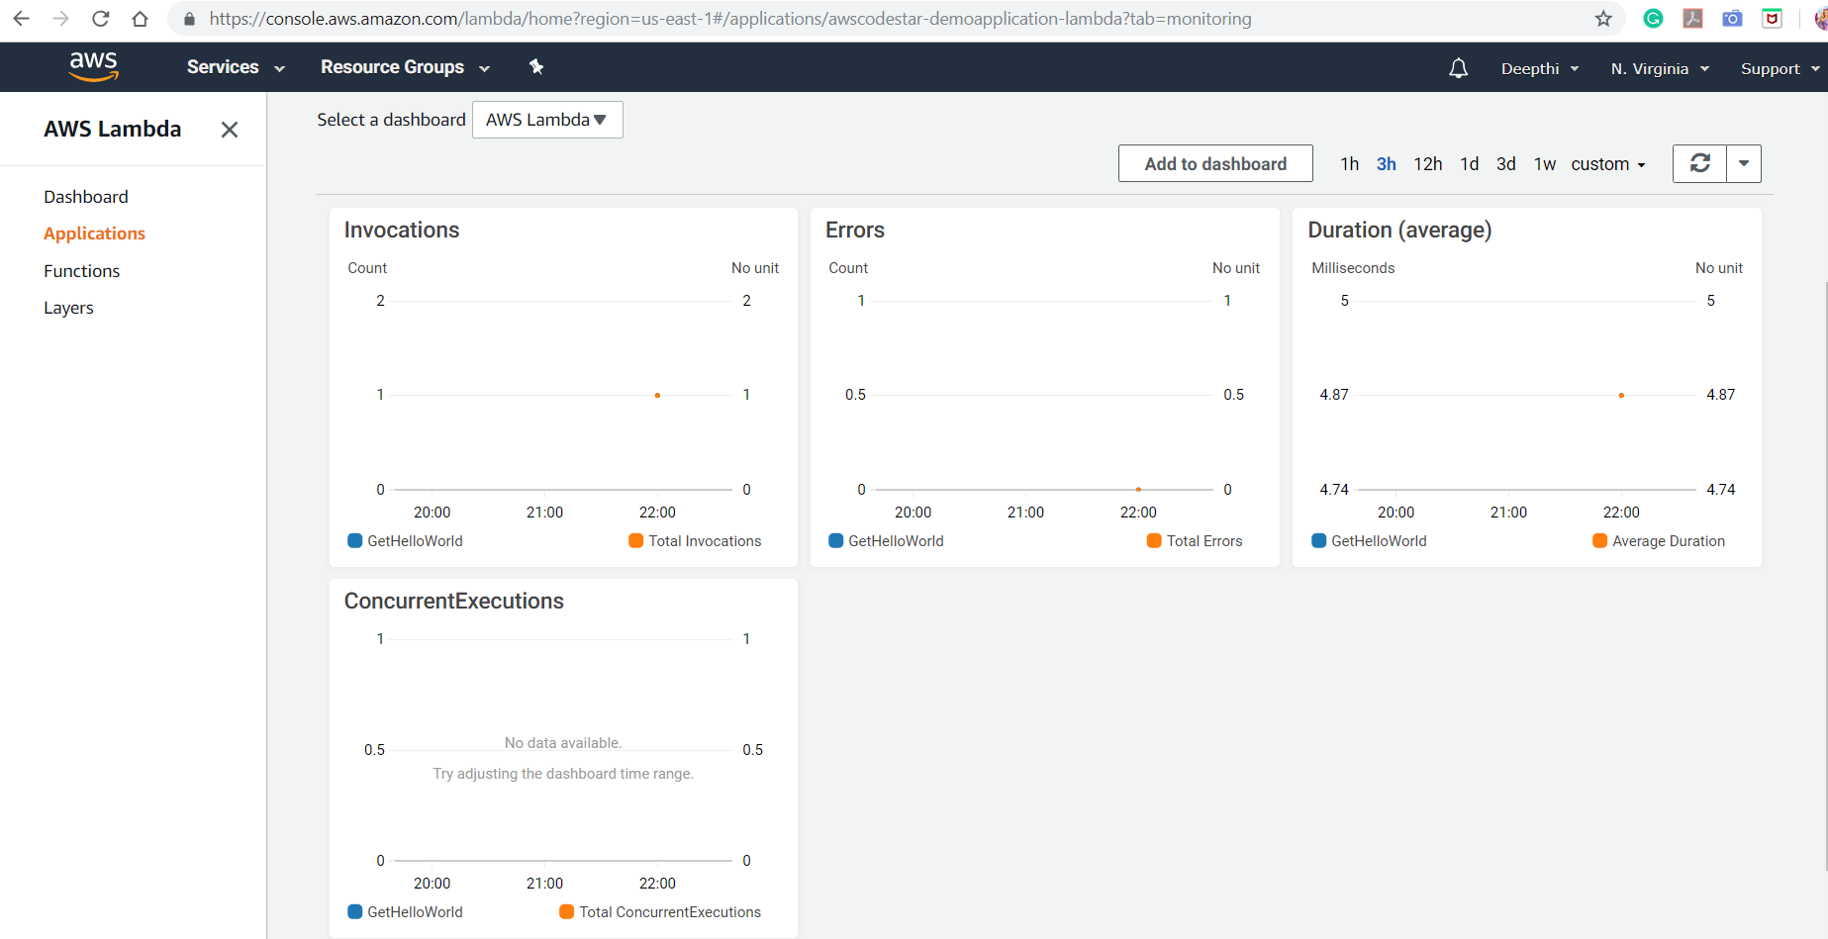

Slide 22
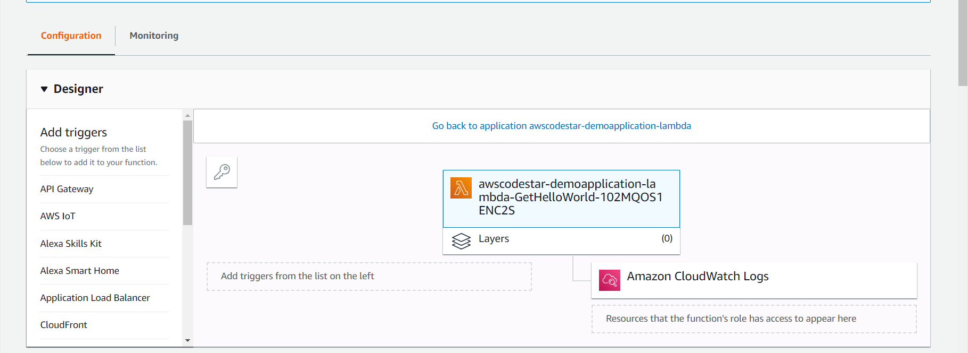

Slide 23
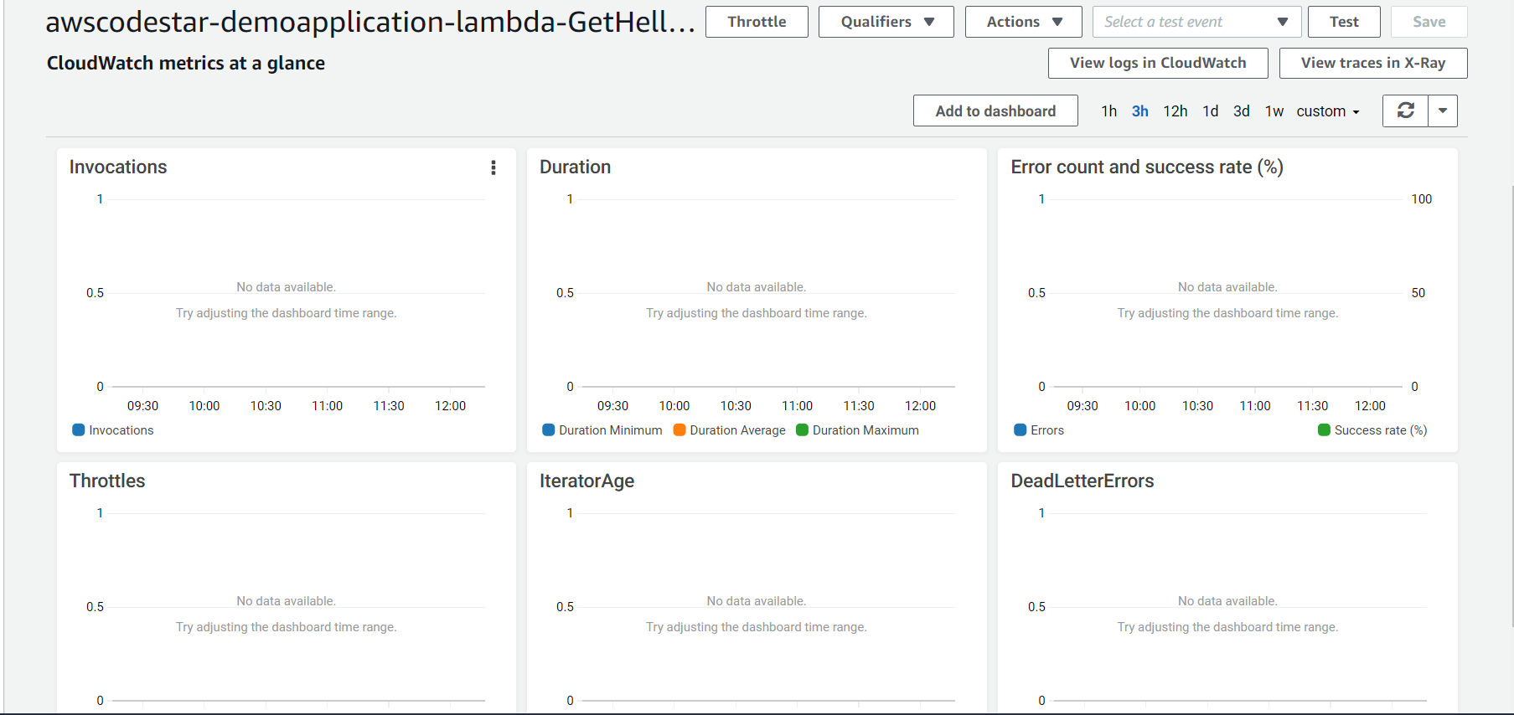
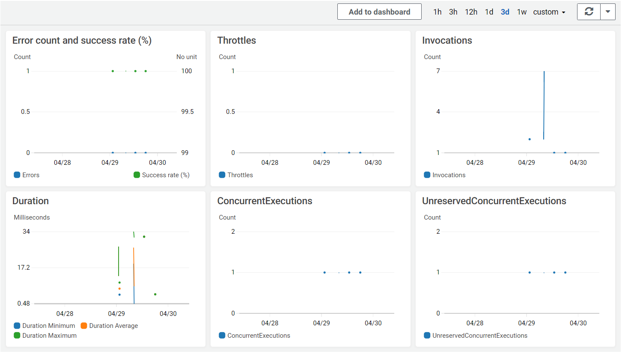
Cloud watch logs

Slide 24
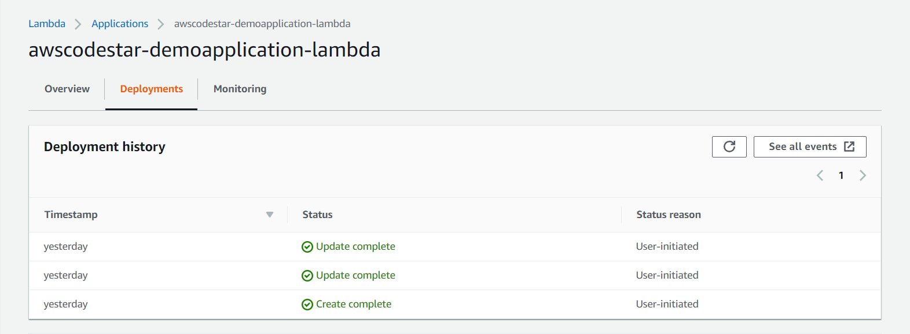

Slide 25
APPICATIONS DEPLOYED
Aws Application Url:
https://5yynqkbqh7.execute-api.us-east-1.amazonaws.com/Prod/
Azure application deployed:
https://webapplication20190414024412.azurewebsites.net/

